Slide 1

Warm up - Bob Brothers
Warm up: 3/14/23
Write or draw about a positive thought that is hard for you to have.

Slide 2

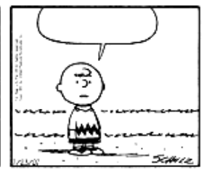
Create your own comic
Write an inner critic comic on the top visual and an inner coach comic on the bottom visual.
A character is talking to themself
Done early?
Get approval
and then add
color!
Maybe they are right, maybe I am ugly…
I shouldn’t listen to them! It’s not true!

Slide 3
You can’t do it, so don’t even bother trying.
You are the worst friend. Why would anyone want to be friends with you?

Slide 4


Slide 5
Pick something that you are having a hard time letting go of.
Something you are maybe not proud of, mad at ourselves for, or sad/disappointed about.
This can be something that you did, said or even thought.
I am upset that I _______________

Slide 6
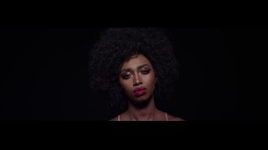
I am upset that I _______________
I forgive myself for ________________________.
I will take responsibility for what is in my control and I will______________________________.

Slide 7
Main character: “What am I going to do… everyone's laughing at me…”
Inner critic: “Of course they are laughing at you! You tried to give an answer and it was wrong! You are a fool!”
Main character: “Oh gosh, I am never sharing an answer again!”
Inner coach: “Wait wait wait! Your ideas are awesome! So you messed up this time, so what! Try again and share your idea about pizza! Everyone will love it!
Main character: “Oh you are right! Then they will see my true genius! Here I go!”

Slide 8
How can we diversely add inner thoughts into a play?
Monologue with “self”, “inner coach” and “inner critic”
Two different scenes (comic)
Play “freezes” to hear inner thoughts

Slide 9
‘Don’t try so hard, it’s not cool.’
‘You’re not good enough to_________.’
‘You really messed up. You can’t do anything right.’
‘Another mistake. You are really stupid.’
‘Nobody likes you.’
‘Don’t wear that or they’ll make fun of you...’
‘People won’t like you if you ________.’
You can’t do it, so don’t even bother trying.
You are the worst friend. Why would anyone want to be friends with you?

Slide 10
Seating Chart - Bobs
Jayden | David | Avniel |  | Keira | Issac | Carlos | Yosiah
RJ | Joaquin | Brielle
Serenity | Aiden |  |  | Monique | Sharae | Kevin

Slide 11
Seating Chart - Depps
Natalia | Dylan | Andre |  | Jasiah | Adan | Endo | Aubree
Jessica | Rico | Angel
Jayleen | Monica |  |  | Azaria | Sophia | Esme | Carlos

Slide 12
Coding goals:
Understand how to talk to a computer by typing commands
Use coding to solve problems with variables.
Use coding to create visuals with fractions.

Slide 13
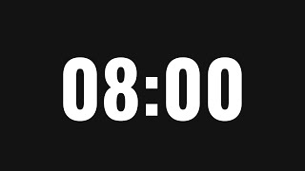
Introduction to Variables and Comments
Does the output change if you change a comment?
Can you change the code so that it will print 5?

Slide 14
Variables for linear equations

Slide 15
Strings
Print all the names of the people in your group!

Slide 16
Concatenating Strings = combining strings together
Print a sentence for each person!

Slide 17
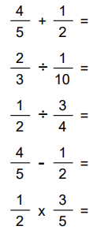
Object oriented programming using fractions
Assign your variable to be a fraction
Solve fraction math problems like these:

Slide 18
Complex Fraction Operations
Can you make an equation where the answer comes out to be 20?
1?
0?
1,000,000

Slide 19
Shout outs!

Slide 20
Lesson 2a

Slide 21
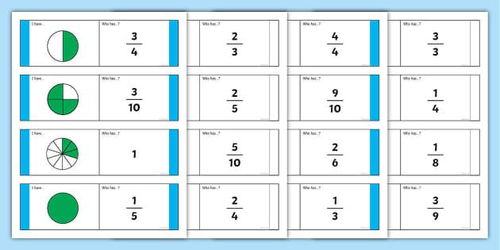
Representing fractions using pictures
Use the coding to show different fractions
What is the biggest denominator you can make?
Can you make a fraction greater than 1?

Slide 22
Multiple fractions using pictures
Use the coding to show 4 equivalent fractions
Use the coding to show 3 fractions in order from least to greatest
Use the coding to show skip counting by ¼‘s to get to 2 wholes.

Slide 23
Shout outs!

